Slide 1
Rockbuster Stealth Data Analysis
Sorin Catighera
October 2024
Slide 1

Slide 2
Contents
Introduction | Presents the context and the research questions.
Data Analysis Findings | 1. Movies that contributed the most/least to revenue. 2. Most popular movie categories. 3. Descriptive statistics for all videos. 4. Top 10 countries for Rockbuster based on the number of customers. 5. Locations of the customers with a high lifetime value. 6. Geographic regions which drive the highest sales.
Insights Summary | Insights gained from the data analysis.
Recommendations | Recommendations for Rockbuster’s board of directors.
Tableau | Tableau link to the charts included in this presentation.
Slide 2

Slide 3
Introduction
Context
Rockbuster Stealth LLC is a movie rental company planning to use its existing movie licenses to launch an online video rental service.
Rockbuster Stealth aims to establish itself as a strong competitor to Netflix and Amazon Prime by offering a diverse selection of movie genres to a global audience, accessible across multiple platforms, including smart TVs, Apple TV, smartphones, and other devices.
Research Questions
Which movies contributed the most/least to revenue gain?
Which movie categories are the most popular?
What was the average rental duration for all videos?
What are the top 10 countries for Rockbuster based on the number of customers?
In which locations are customers with a high lifetime value primarily located?
Which regions are driving the highest sales?
Slide 3

Slide 4
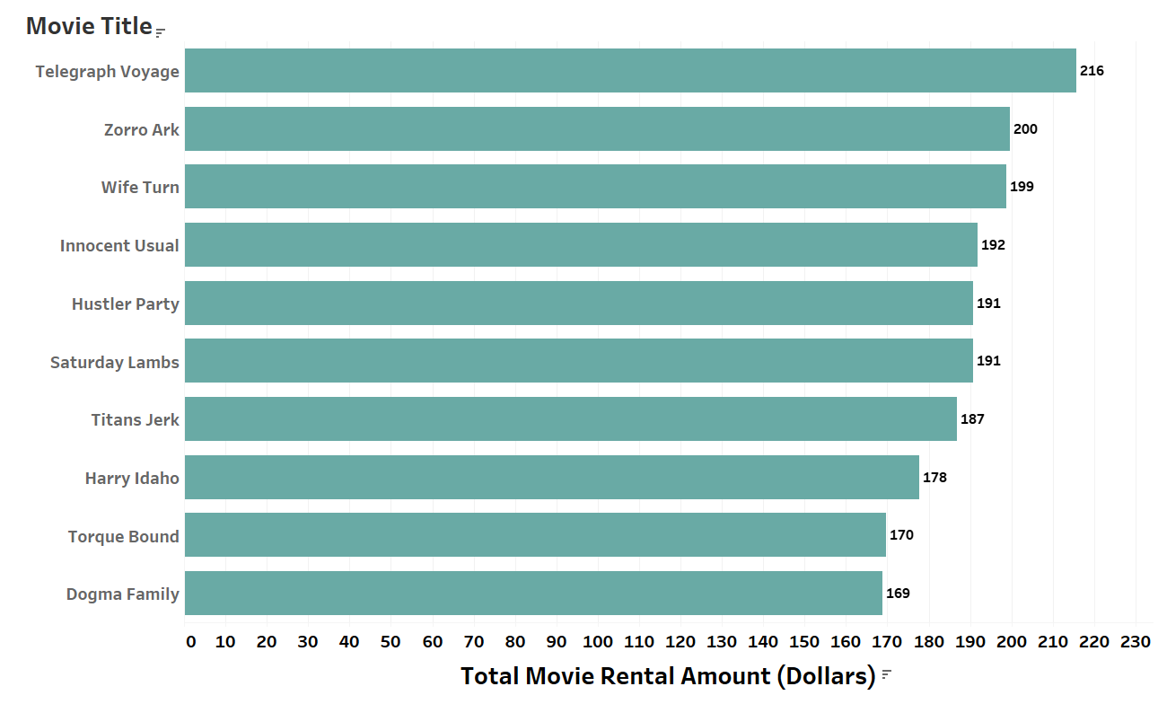
1. a) Movies that contributed the most to revenue.
Data Analysis Findings
The top rental movie was 'Telegraph Voyage’, categorized as a music film.
Slide 4

Slide 5
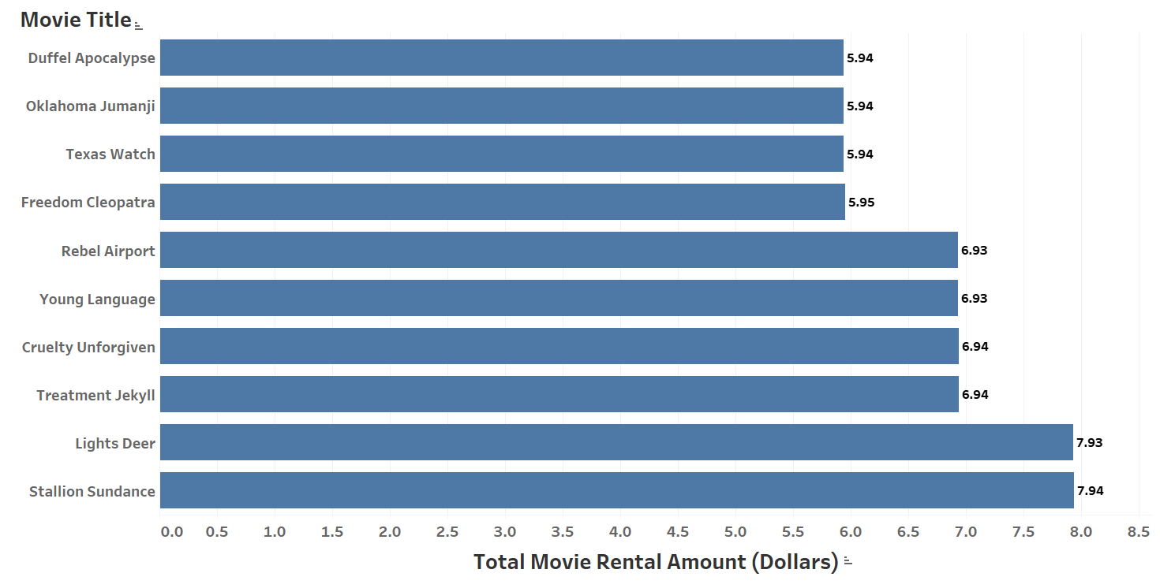
1. b) Movies that contributed the least to revenue.
There were three movies that contributed the least: ‘Duffel Apocalypse’, ‘Oklahoma Jumanji’, and ‘Texas Watch’, categorized as Horror, New, and Documentary.
Slide 5

Slide 6
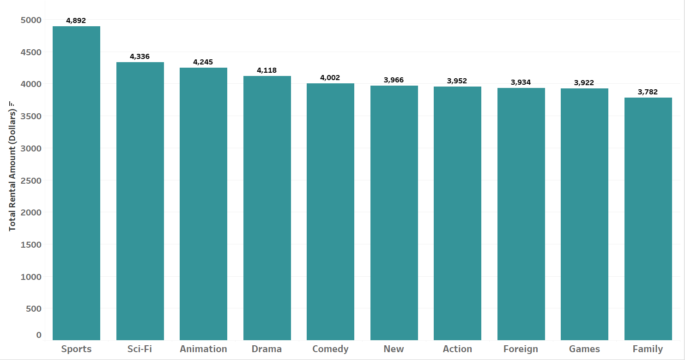
2. Most popular movie categories.
Sports was at the top of movie categories (12%), followed by Sci-Fi (10.5%), Animation (10.3%),
Drama (10%), and Comedy (9.7%).
Slide 6

Slide 7
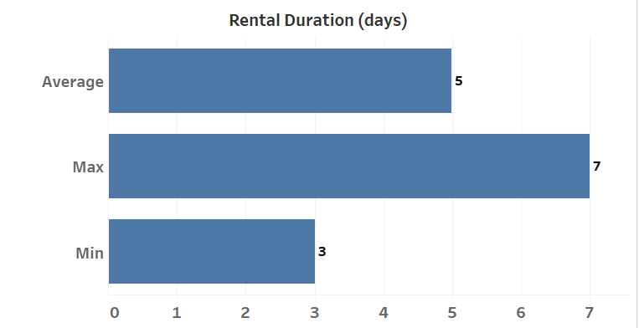
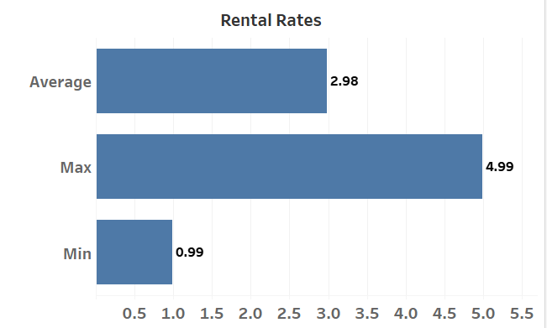
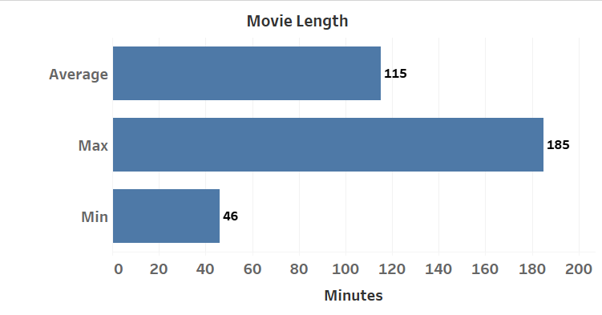
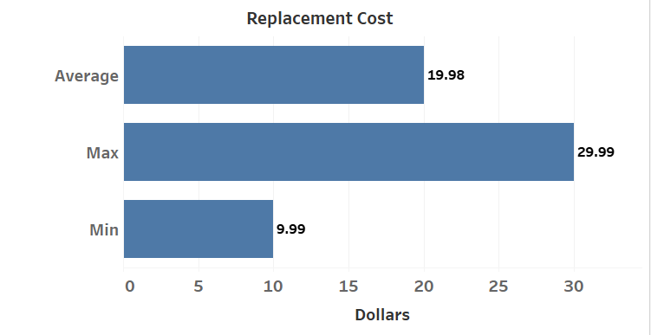
3. Descriptive statistics for all videos
The average rental duration for all videos was 5 days.
Overall, the average rental rate was balanced, at almost $3.
The preferred movie length was 115 minutes.
The average replacement cost was around $20.
Slide 7

Slide 8
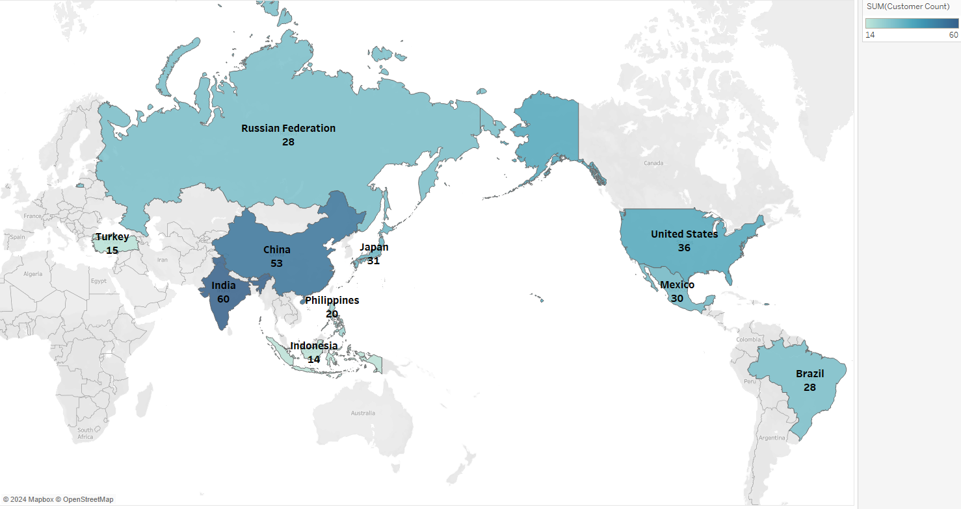
4. The top 10 countries for Rockbuster based on the number of customers.
The largest customer base was in India (19%), China (16.8%), United States (11.4%),
Japan (9.8%), and Mexico (9.5%).
Country | Count
India | 60
China | 53
U.S.A | 36
Japan | 31
Mexico | 30
Brazil | 28
Russia | 28
Philippines | 20
Turkey | 15
Indonesia | 14
Slide 8

Slide 9
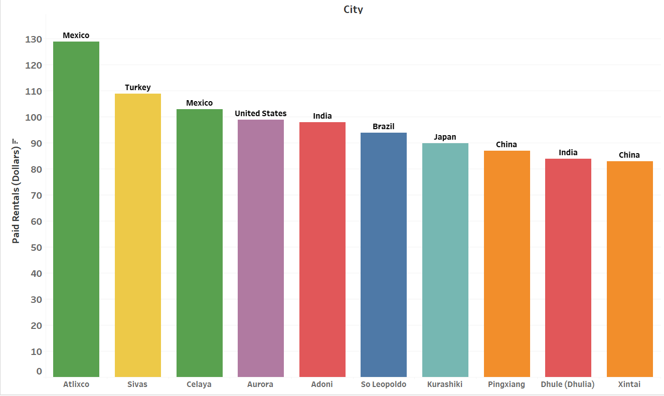
5. Locations of the customers with a high lifetime value.
Customers with a high lifetime value are located in Atlixco (Mexico), Sivas (Turkey),
Celaya (Mexico), Aurora (United States), Adoni (India).
Slide 9

Slide 10
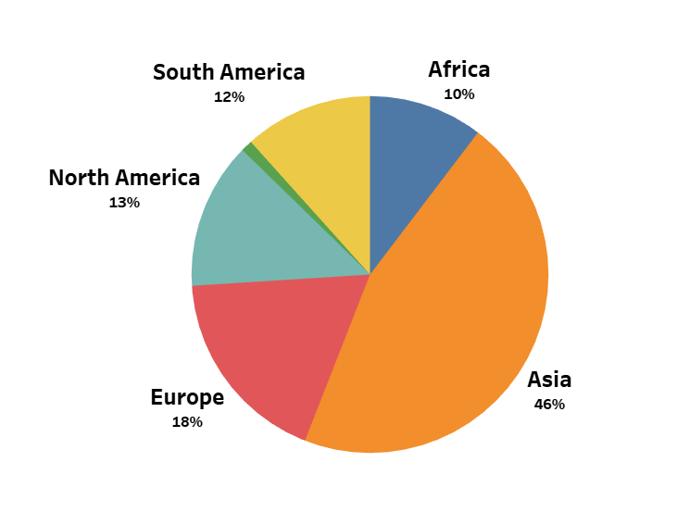
6. Geographic regions which drive the highest sales.
Asia is driving the highest sales, with 45.6% of the total. Europe, North America,
and South America are the next largest contributors with 18%, 13%, and 11% respectively.
Slide 10

Slide 11
Insights Summary
Movie Categories
Sports was at the top of movie categories (12%), followed by Sci-Fi (10.5%), Animation (10.3%), Drama (10%), and Comedy (9.7%).
The top rental movie was 'Telegraph Voyage,' which was categorized as a music film.
Three movies had the lowest contribution to revenue: ‘Duffel Apocalypse’, ‘Oklahoma Jumanji’, and ‘Texas Watch’, categorized as Horror, New, and Documentary.
Rental Statistics
The average rental duration for all videos was 5 days.
Overall, the average rental rate was balanced, at almost $3.00.
The preferred movie length was 115 minutes.
The average replacement cost was around $20.
Slide 11

Slide 12
Insights Summary
Customer Base and Sales
The largest customer base was in India (19%), China (16.8%), United States (11.4%), Japan (9.8%), and Mexico (9.5%).
Customers with a high lifetime value are located in Atlixco (Mexico), Sivas (Turkey), Celaya (Mexico), Aurora (United States), Adoni (India).
Asia is driving the highest sales, with 45.6% of the total. Europe, North America, and South America are the next largest contributors with 18%, 13%, and 11% respectively.
Slide 12

Slide 13
Recommendations
Marketing
The marketing resources need to be allocated based on market size, with priority given to Asia, North America and the European Union.
Create an exclusive loyalty program that offers special perks such as early access to new releases and discounted rentals for customers with a high lifetime value.
Business Development
Increase localized content for the Asian market, for example invest in Bollywood movies, obtain more licenses for martial arts and Chinese mythology movies.
Priority for acquiring new licenses should be given to the following movie categories, in this order: Sports, Sci-Fi, Animation, Drama, and Comedy.
Introduce premium pricing strategies for new releases in the Sports, Sci-Fi, and Animation categories.
Slide 13

Slide 14
Recommendations
Customer Focus
Provide multilingual support, such as subtitles and dubbing in languages spoken by the target markets (e.g. Mandarin, Hindi, Punjabi, Tamil).
Provide dedicated customer support for high-value customers, ensuring their issues are resolved promptly and efficiently.
Ensure that the inventory aligns with customer preferences based on country.
Slide 14

Slide 15
Thank you!
Slide 15

